Slide 1
Metropolitan Area School Systems
School Support Organizations– November 4, 2015
Not Your Mother’s SSO
L. Rene Brison, CPA, CFE, Assistant Director
Special Investigations
(615) 401-7907
rene.brison@cot.tn.gov

Slide 2
School Support Organizations
(learning objectives)
What is required
Why is it important?

Slide 3
Over the Years
Internal School Acctg Law (1959)
Sales tax implications
IRS implications
School Uniform Accounting Policy Manual (1976)
  SSOs specifically exempted from audit

Slide 4

School Support Organization Financial Accountability Act
[2007 (Amended in 2008)]
Section 49-2-601, TCA

Slide 5
Legislative Intent
Promote accountability and consumer confidence in SSOs
Protect SSOs from certain personal civil liability through incorporation;
Provide legitimacy to SSOs

Slide 6
Legislative Intent
Ensure the continued support of academic, arts, athletic and social programs, which help educate the children of Tennessee
Ensure fiscal accountability of school support organizations

Slide 7
SSOFAA – Covers WHO/WHAT?
Any nongovernmental groups or organizations which
  Raise money in the name of a school
  Raise money for the benefit of the school and its students.

Slide 8
What is a School Support Organization?
Booster club, foundation, PTA, PTO, PTSA….
Group whose primary purpose is to support a school or school activity and which collects or receives money for that purpose

Slide 9
Who or What is NOT a School Support Organization?
Groups or persons who solicit donations given directly to school
Persons who volunteer or assist in school fundraisers

Slide 10
SSOFAA Definitions
“Internal school funds”
Any and all money received and accounted for at the individual schools

Slide 11
SSOFAA Definitions
“School support organization funds”
Money, materials, property or securities raised by an SSO

Slide 12
Two Paths From Which To Choose…
Collections accounted for by SSO
Collections
accounted
for by school

Slide 13
School Money??
The school becomes accountable when money is initially received by employees, officials or volunteers acting in their official capacity.
TISUAPM 5-3

Slide 14
School Money
Donations
Cafeteria funds
Fees
School Board Allocations
Funds raised through cooperative agreements
Rental Fees
Student Activity Funds

Slide 15
School Money
Student Activity Funds
  School sponsored academic, art, athletic or social event involving students
  Raised by school sponsored clubs
  Raised by school sponsored fundraisers involving students under supervision of a school employee

Slide 16
School Money
Student Activity Funds (cont.)
  Commissions for direct sale of items to student pursuant to cooperative agreement
  School-run bookstore collections
  Fees charged to students
  Interest on school bank accounts
  Any school sponsored activity involving use of school personnel, students, and property during the school day

Slide 17
Through the School
School employee takes charge of the fundraiser
School employee is accountable in any way for collections

Slide 18
Members/parents of SSO are VOLUNTEERS
for the SCHOOL fundraiser.

Slide 19
“VOLUNTEERS” are not SSOs

Slide 20
?
Do we have to have a booster club?
Depends

Slide 21
The Other Path!!!
What must be done before a group can fundraise as an SSO?

Slide 22
SSO as a
“Nonprofit Organization”
Charter
This law does not require an SSO be a 501(c)(3) under IRS.

Slide 23
Questions:
If we don’t have a booster club, do we still have to do a cooperative agreement?
NO….probably
If we don’t have a booster club, do we still have to file a charter with the state?
NO

Slide 24
Questions:
Student Accounts (read question)

Slide 25
Questions:
Students required to pay for clays. Accounts set up to account for that. Is this legal???

Slide 26
Questions:
Elaborate on the fee structure for a program??? What guidelines should I use for setting them??? How does team travel weigh into the schedule?
  Fees for school-sponsored activities must be accounted for through the school.

Slide 27
The Other Path!!!
What must be done before a group can fundraise as an SSO? (cont.)

Slide 28
Board Policy
Board Policy
Board Policy
Board Policy

Slide 29
Board Policy
Cooperative Agreements
School Support Organizations
Use of school facilities for fundraising purposes

Slide 30
Board Policy Must Require a Form Documenting:
    Status as a nonprofit org chartered with the State of TN (or chartered member)
    Goals and objectives
    Telephone number, address, and position of ach officer

Slide 31
Board Policy Must Require:
Before the end of the school year, the organization shall provide at a minimum a statement of total revenues and disbursements to the director or the director’s designee.

Slide 32
Board Policy Must Require:
Required approval by Director of Schools/Director’s Designee of all SSO fundraising activity

Slide 33
TSBA Model Board Policy
Reflects Requirements of
State law (TCA)
{And a few other things}

Slide 34
School Board Policy
May be
MORE RESTRICTIVE
than requirements in SSOFAA

Slide 35
School Board Policy
All required forms, annual reports or financial statements shall be open to public inspection!

Slide 36
Responsibility of the
Director of Schools and/or BOE
Post or publish a list of SSOs in compliance with TCA, Section 604(b)
Develop a process to certify that an SSO has been recognized as an SSO
Approve SSO fundraising

Slide 37
Responsibility of SSO
Obtain/retain charter, (keep copy)
Annually file with Sec. of State and keep doc’t of nonprofit status
Maintain bylaws

Slide 38
Responsibility of SSO
Keep minutes of meetings
Maintain detailed statements of receipts and disbursements

Slide 39
Responsibility of SSO –
Accounting Policy
Specifies reasonable procedures for accounting, controlling, and safeguarding any money materials, property or securities collected or disbursed by it.

Slide 40
Responsibility of SSO
Separate financial duties
Comply with sales tax provisions
Prepare profit analyses
Prepare treasurer’s manual
Designate custodian of records
Form a financial review committee or designate financial reviewer

Slide 41
Meetings/Activities
Active Membership (decisions made by SSO - not just dictated by principals coaches, directors, etc.)
Transparent
Informative (Detailed $$)

Slide 42
Meetings/Activities
Activities in line with stated goals and objectives.
Activities abide by Federal, State and local laws
Operate within applicable standards/guidelines of related state organizations (TSSAA)

Slide 43
Minutes
Bank name, authorized accounts (in SSO name), authorized signatories
Monthly signed financial report with monthly bank statement and imaged checks

Slide 44
Minutes
Date, location and board members present
Actions taken
Other significant discussions

Slide 45
Responsibility of SSO
Ensure money is safeguarded and spent only for purposes related to the goals and objectives of the organization.

Slide 46
Responsibility of SSO
Get fundraisers approved by director of schools/designee
Ensure ownership of all property and equipment is in name of SSO

Slide 47
Responsibility of SSO
Adhere to accounting and financial policies and procedures in the Model Financial Policy for School Support Organizations (Procedures Manual)

Slide 48
Model Financial Policy
Pay by check (not cash). Never pre-sign!
Use prenumbered checks with 2 signatures.
Obtain and retain documentation (receipt, invoice, etc.) for EVERY withdrawal (check, cash, debit card). Include check #.

Slide 49
Questions:
How should coaches or booster club parents be reimbursed?
  By prenumbered check. Adequate documentation (showing receipt of goods and services and that they benefit booster club) should be filed and maintained

Slide 50
Model Financial Policy
Donations
To school or BOE
  Prepare and retain copy of written conditions
  (school MUST spend accordingly)

Slide 51
Model Financial Policy
Treasurer issue prenumbered receipt when $$ turned over (One copy maintained in receipt book)
Applicable collections counted by two persons who prepare and sign count sheet and get receipt from treasurer

Slide 52
Model Financial Policy
Deposit money promptly
Itemized deposit slips
  Add source of deposit
Timely reconcile bank statements.

Slide 53
Records
Organize by fiscal year (collection records, bank statements, imaged checks, invoices, etc.)
Maintain at least 4 years

Slide 54
School Support Organizations
A school representative may NOT serve as treasurer or bookkeeper of an SSO or be a signatory on the checks.

Slide 55
School Representative
School Board Member
Director of Schools
District Finance Director (individual primarily responsible for accounting for school system funds)
School Principal
School Bookkeeper, and…

Slide 56
School Representative
Any individual who works
for the school system and
who as a part of their employment by the school system is charged with directing or assisting
in directing the related
school club or activity.

Slide 57
SSO Focus Issues
  SSO may operate:

Slide 58
Concessions

Slide 59
Parking

Slide 60
Bookstore

Slide 61
With
  Approval
  Written agreement
  Required recordkeeping provided to school

Slide 62
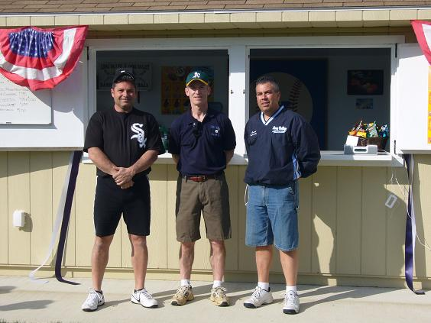
Applicable Fundraisers (Concessions)
Collections counted by two persons who sign/date record of count
Documentation for all disbursements
Inventory safeguarded and counted
Profit Analysis
Collection documentation provided to school (concessions, parking, bookstore)

Slide 63
Also, a principal may allow funds raised by fundraisers conducted by an SSO outside the school day and involving students to be collected during the school day by the SSO. Such funds shall be SSO funds provided school employees are not involved in the accounting of such funds and the funds are turned-in using sealed envelopes.

Slide 64
SSOs May NOT
Use the school or district sales tax exemption
Represent or imply that its activities…, contracts, purchases, or financial commitments are made on behalf of or binding upon any school or school district
Use school money for a purpose other than purposes related to goals and objectives
Use the school’s EIN

Slide 65
SSO Focus Issues
Upon request SSO SHALL provide access to all books, records and bank information for the organization
to any member, BOE, Principal,
Tennessee Comptroller

Slide 66
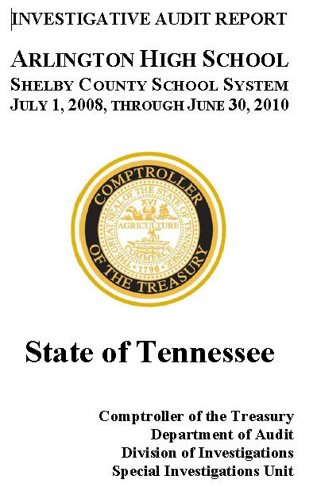
SSO Focus Issues
Subject to audit by Comptroller of the Treasury

Slide 67
Report Suspected Fraud

Slide 68
Compensation to Employees?
Make sure Board is aware
Comply with Board Policy
Comply with TSSAA Policy
Be aware of Title 9
Comply with IRS

Slide 69
TSSAA
Bylaws, Section 9, page 10.

Slide 70
Questions:
Can non-faculty coaches be paid by the booster club and reported on 1099?
  Board Policy!!
  Considerations:
    School liability issues?
    Amounts paid a concern?

Slide 71
Questions:
Is Booster Club responsible for payment of FICA & Retirement expenses for contracted employees?
Board policy!!!!

Slide 72
Questions:
Why are certified employees taxed twice on the “Miscellaneous Contract Labor Payment Request” form?
??????

Slide 73
Questions:
Can we run baseball camps through the booster club and report them on our 1099 like we have in the past?
  Can not be advertised as a school sponsored event. Make sure rental/written agreements in place.

Slide 74
Questions:
Will we be given a master list of things to take care of - with completion dates!
  A great idea….but not required.

Slide 75
School Officials NOT Liable for SSO
Local school officials shall not incur any liability for the failure of an SSO to safeguard SSO funds

Slide 76
Rene’s Top 4 Most Important Controls for SSOs

Slide 77
Review Fundraiser Profit Analysis Reports
4

Slide 78
Compare Collection Records with Receipts and Deposits by Treasurer
3

Slide 79
Review credit/debit card payments
  Payments
  Detail receipts
2

Slide 80
  Also…. CASH ADVANCES

Slide 81
1
Review Bank Statements

Slide 82
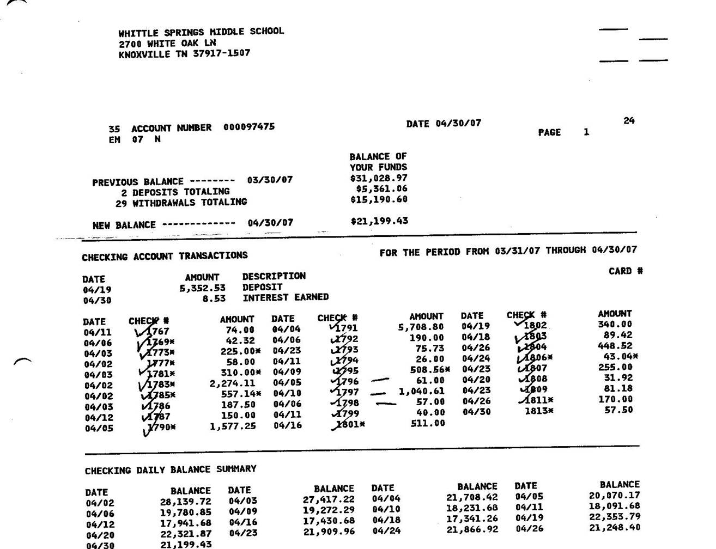
Review of Original Bank Statements
Number of Deposits
Timing of Deposits
Amount of Deposits
Amounts on checks
Payees on checks

Slide 83
Contact Me
L. Rene Brison, CPA, CFE,
Assistant Director
Special Investigations
(615) 401-7865
rene.brison@cot.tn.gov

